Slide 1
AN AUTOMATED EMAIL SERVICE BY CONVERSATIONAL AI
DOMAIN : Artificial Intelligence
TEAM MEMBERS :
1) HARIRAM B – 212219220012
2) ANANDASAYANAM K – 212219220002
3) MAHESWARA PANDIAN G - 212219220029

Slide 2
DOMAIN :
Artificial intelligence (AI) is the ability of a computer program or a machine to think and learn. It is also a field of study which tries to make computers "smart". They work on their own without being encoded with commands.

Slide 3
SUB DOMAIN :
Conversational artificial intelligence (AI) refers to technologies, like chatbots or virtual agents , which users can talk to. They use large volumes of data , machine learning, and natural language processing to help imitate human interactions, recognizing speech and text inputs and translating their meanings across various languages.

Slide 4
ABSTRACT :
Electronic mail (email or e-mail) is a method of exchanging messages (“mail”) between people using electronic devices. Email operates across computer networks, primarily the Internet. In this project model, a user can send text messages through voice by a conversational Artificial intelligence to a recipient. The conversational AI recognizes user’s speech and input and perform operations accordingly.

Slide 5
OBJECTIVE :
To send email message to a recipient (without typing) by speaking to a conversational AI.

Slide 6
EXISTING SYSTEM :
Today's email systems are based on a store-and-forward model. Email servers accept, forward, deliver, and store messages. Neither the users nor their computers are required to be online simultaneously; they need to connect, typically to a mail server or a webmail interface to send or receive messages or download it. The users send text messages only by typing or forwarding.

Slide 7
PROPOSED SYSTEM :
By the existing method, the user can only type the message or forward it to a recipient. But by this project model, a user can speak to a conversational AI and send email without typing. Conversational AI studies human conversation and language processing to mimic speech and make the user feel like they are merely talking to another person. This is exactly what developers want conversational AI to imitate. When technology conveys emotion and meaning, the user feels more comfortable conversing with it.

Slide 8
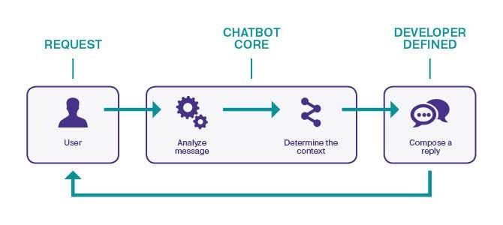
DIAGRAM OF PROPOSED SYSTEM :

Slide 9
ADVANTAGES :
Chatbots are always supposed to be the superstars of artificial intelligence for customer service. These chatbots help customers in solving their problems faster and accurately. Thus, they similarly perform as outstanding assistants to agents.
Eliminate Tedious Time-Consuming Tasks and save time.

Slide 10
CHALLENGES :
1. Security and privacy : At the point when users demand a voice assistant, the information sent must be safely prepared and put away. 2. Discovery and adoption : Although Conversational AI applications are getting progressively simple to use and standardized for everybody, there are still difficulties that can be defeated to expand the number of individuals who are open to using technology for a more extensive variety of use cases.

Slide 11
APPLICATIONS :
Customer Support.
Banking and Finance.
Retail and Commerce.

Slide 12
LITERATURE REVIEW :
1. Xinmeng Song (2021) Based on the results, we find the following insights: (1) The evolution of conversational AI research involves many categories while two major disciplines—computer science and ergonomics—lead the way. (2) The current research can be divided into two research areas: underlying technology architecture and smart scene applications. By using multiple commultipleplementary scientometric methods, our study visually presents the research history, current research hotspots and emerging trends in the field of conversational AI, to further promote its technology and application research.

Slide 13
2. Rui Yan (2018), states Conversational AI is of growing importance since it enables easy interaction interface between humans and computers.To build a conversational system with moderate intelligence is challenging, and requires abundant dialogue data and interdisciplinary techniques. A-long with the Web 2.0, the massive data available greatly facilitate data-driven methods such as deep learning for human-computer conversations. In general, conversational systems can be categorized into 1) task-oriented systems which aim to help users accomplish goals in vertical domains, and 2) social chat bots which can converse seamlessly and appropriately with humans, playing the role of a chat companion. In this paper, we focus on the survey of non-task-oriented chit-chat bots.

Slide 14
3. Sinarwati Mohamad Suhaili, Naomie Salim, Mohamad Nazim Jambli (2021) The primary purpose of this literature review is to identify and study the existing literature on cutting-edge technology in developing chatbots in terms of research trends, their components and techniques, datasets and domains used, as well as evaluation metrics most used between 2011 and 2020. Using the standard SLR guidelines designed by Kitchenham, this work adopts a systematic literature review approach and utilizes five prestigious scientific databases for identifying, extracting, and analyzing all relevant publications during the search. The related publications were filtered based on inclusion/exclusion criteria and quality assessment to obtain the final review paper. The results of the review indicate that the exploitation of deep learning and reinforcement learning architecture is the most used technique to understand users’ requests and to generate appropriate responses.

Slide 15
IMPLEMENTATION : PYTHON CODE:
import smtplib import speech_recognition as sr import pyttsx3 from email.message import EmailMessage listener = sr.Recognizer() engine = pyttsx3.init()

Slide 16
def talk(text): engine.say(text) engine.runAndWait() def get_info(): try: with sr.Microphone() as source: print(‘listening...’) voice = listener.listen(source) info = listener.recognize_google(voice) print(info) return info.lower() except: pass

Slide 17
def send_email(receiver, subject, message): server = smtplib.SMTP(‘smtp.gmail.com’, 587) server.starttls() # Make sure to give app access in your Google account server.login(‘Sender_Email’, ‘Sender_Email_password’) email = EmailMessage() email[‘From’] = ‘Sender_Email’ email[‘To’] = receiver email[‘Subject’] = subject email.set_content(message) server.send_message(email)

Slide 18
email_list = { ‘name1’: ‘name1@gmail.com’, 'name2’: ‘name2@gmail.com’, ‘name3’: ‘name3@gmail.com’, ‘name4’: ‘name4@gmail.com’, ‘name5’: ‘name5@gmail.com’ }
def get_email_info(): talk(‘To Whom you want to send email’) name = get_info() receiver = email_list[name] print(receiver)

Slide 19
talk(‘What is the subject of your email?’) subject = get_info() talk(‘Tell me the text in your email’) message = get_info() send_email(receiver, subject, message) talk(‘Your email is sent’) talk(‘Do you want to send more email?’) send_more = get_info() if ‘yes’ in send_more: get_email_info() get_email_info()

Slide 20
OUTPUT :

Slide 21
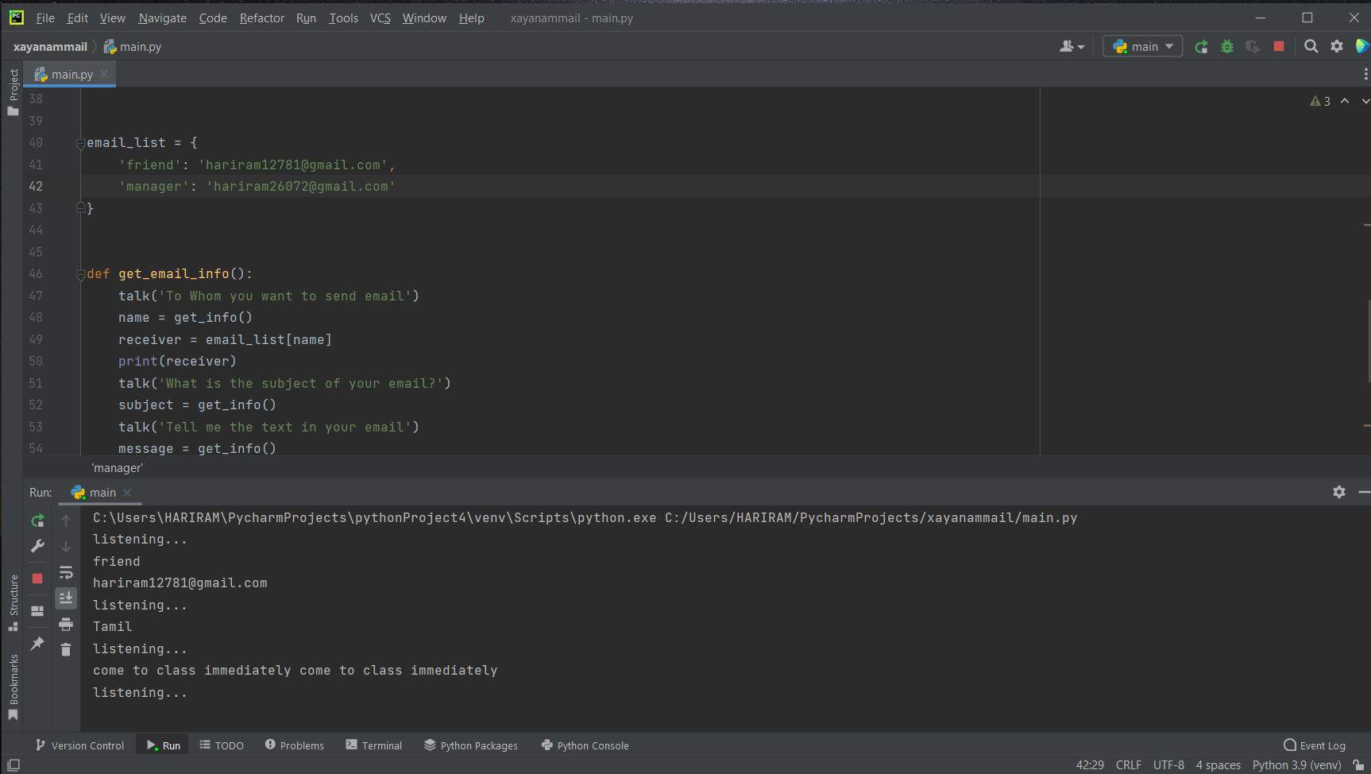
OUTPUT :

Slide 22
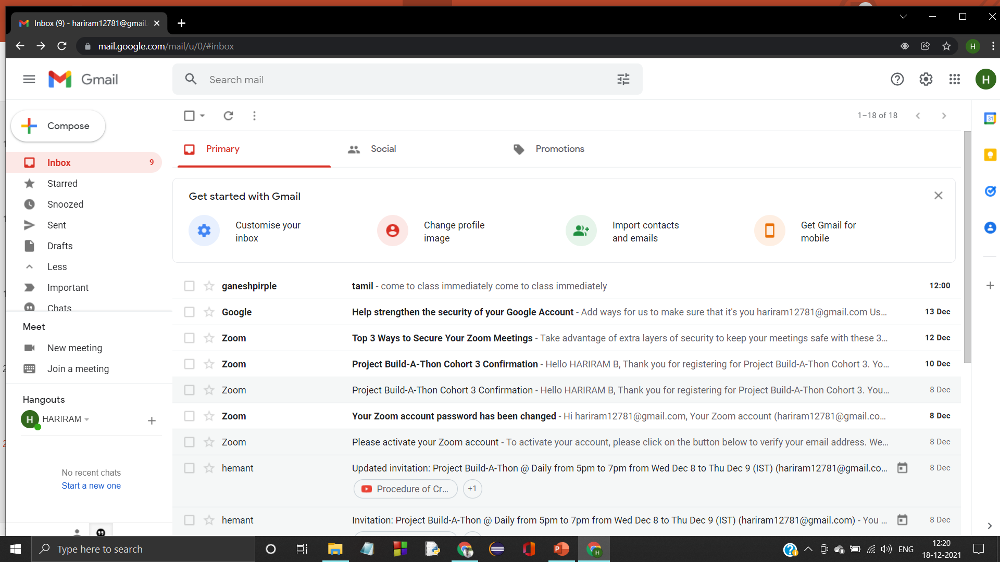

Slide 23
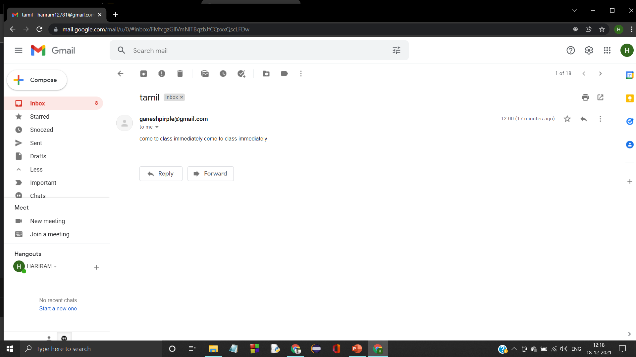

Slide 24
THANK YOU

